Slide 1

Bike Rental Sharing Prediction
Samina J.A.
MD Shakir Nadim
Anil Kumar Rajavarapu
Harsha Vipul Bhatewara
Sahil Rajaram Bachate
Pranal Pradeep Chandgude
Nitesh Kumar Jangid
Guided By
Aishwarya

Slide 2
Problem Statement :
As bike rental sharing has become a popular mode of transportation for short distance commuting in cities it becomes essential to predict the total count of bike rentals to enable the bike rental sharing companies to ensure the availability of bikes for users during peak hours.
Goal of this project :
To develop a predictive model that can accurately forecast the total count of bike rentals based on historical usage data and external factors such as season, weather condition, holidays and so on.

Slide 3
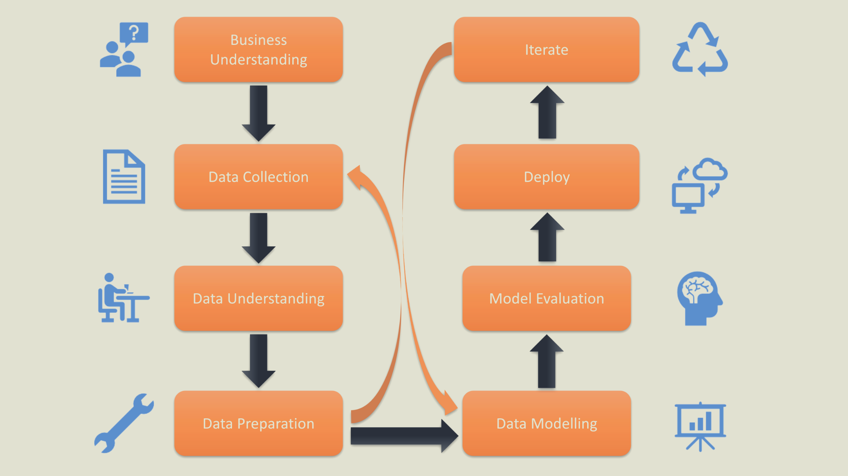
Project Life Cycle

Slide 4
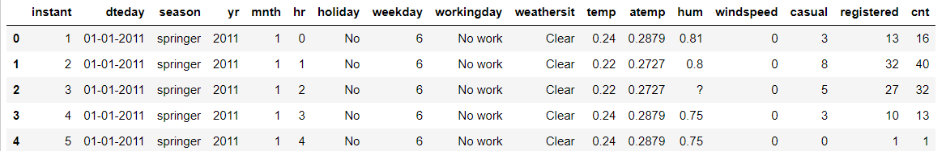
Data Set Details
Data contains previous information on bike bookings based on some features.
Data Has 17 columns and 17278 entries.
:
Sr.No | Column Name | Column Description
1 | Instant | Index number
2 | Dteday | Date (Format: YYYY-MM-DD)
3 | Season | Season Name
4 | Yr | Year
5 | Month | Month (1-12)(Jan-Dec)
6 | Hr | Hour(0 to 23)
7 | Holiday | Whether the holiday is there or not
8 | Weekday | Day of the week
9 | Workingday | Whether it is a working day or not
10 | Weathersit | Weather situation
11 | Temp | Normalized temperature in Celsius
12 | Atemp | Normalized feeling temperature
13 | Hum | Normalized humidity. The Values are divided by 100
14 | Windspeed | Normalized Wind speed. Values are divided by 67
15 | Casual | Count of casual users
16 | Registered | Number of registered users
17 | Cnt | Count of total rental biked including both casual and registered

Slide 5
Data preprocessing
Check for Presence of Special Characters
Replace Special Characters with NAN
Check for Duplicates
Remove Duplicates
Impute missing Value

Slide 6
Exploratory Data Analysis.
It is an approach used in data science to analyze and summarize data sets before applying more advanced techniques. EDA involves examining and visualizing the data to gain insights, identify patterns, detect anomalies, and understand the underlying structure of the data.
In short, EDA helps researchers and analysts to get familiar with their data, uncover relationships between variables, and make informed decisions about subsequent steps in the data analysis process. It often includes tasks such as data cleaning, data visualization, and statistical analysis to explore and understand the data's characteristics and properties.

Slide 7
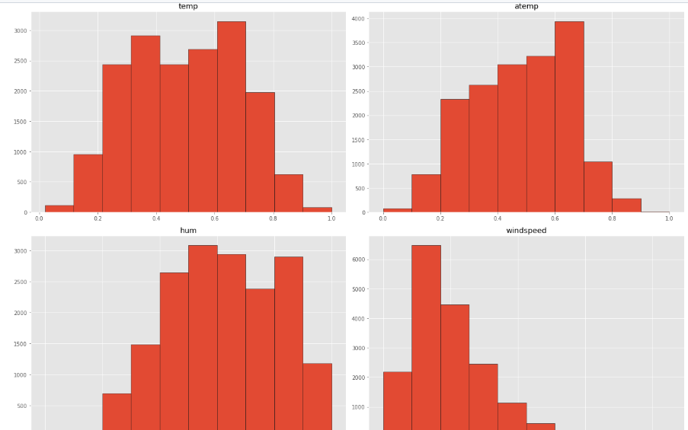
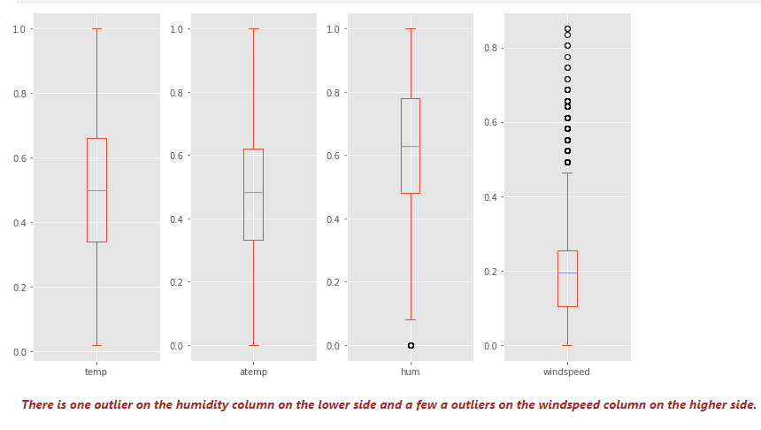
imputing missing value. Capping outliers. FOR HUMIDITY:- IQR METHOD FOR WINDSPEED:- WINSORIZATION
Histogram:
From the plots, temp, and atemp are normally distributed, and humidity and windspeed look left and right-skewed.
Box plot – outlier detection
There is one outlier on the humidity column on the lower side and a few outliers on the windspeed column on the higher side

Slide 8
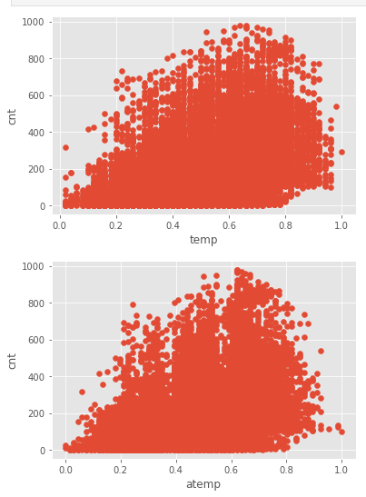
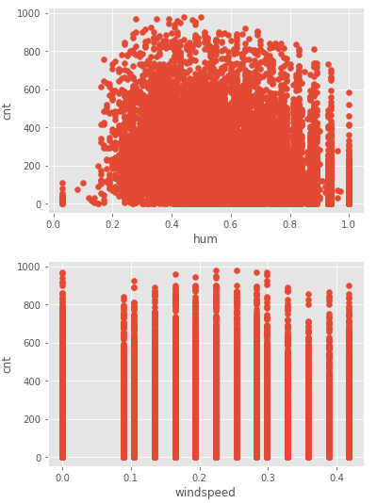
BIVARIATE ANALYSIS
SCATTER PLOT
None of the predictor variables have a linear relationship with the target variable

Slide 9
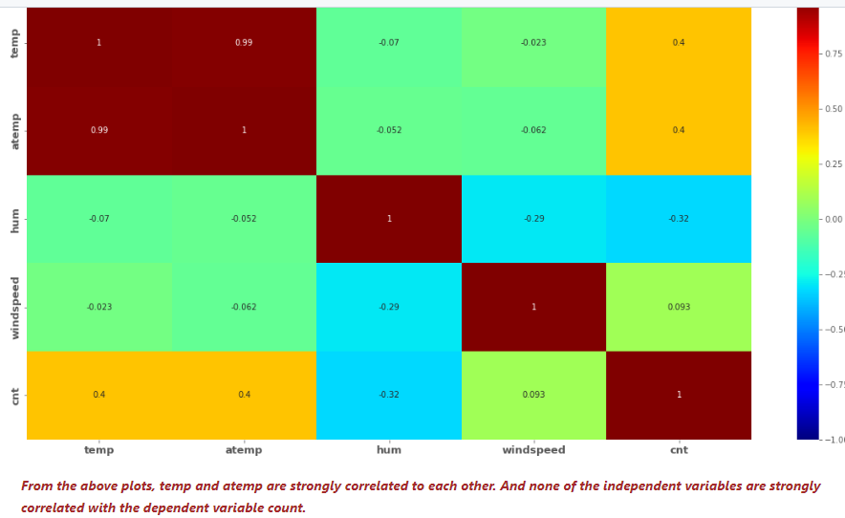
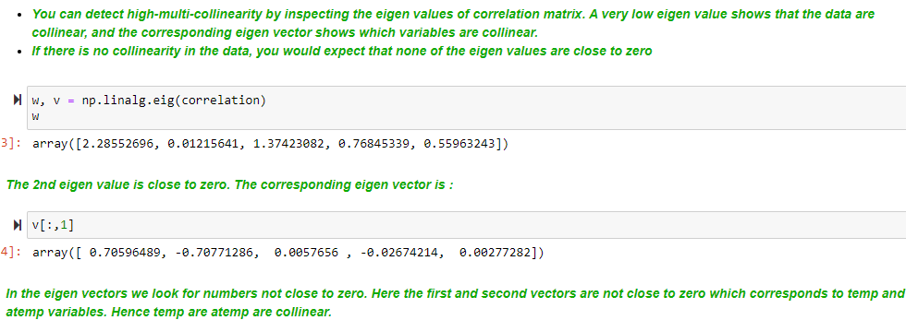
Check for multicollinearity

Slide 10
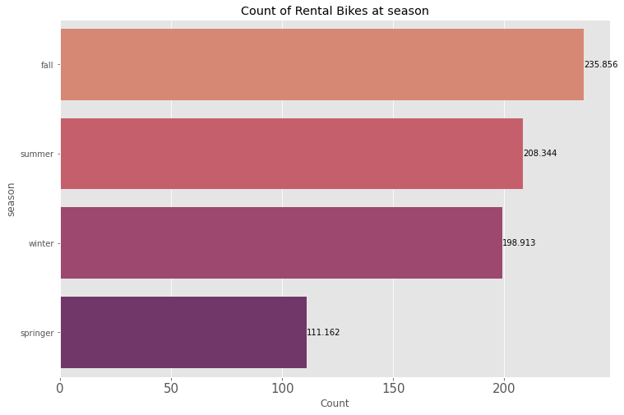
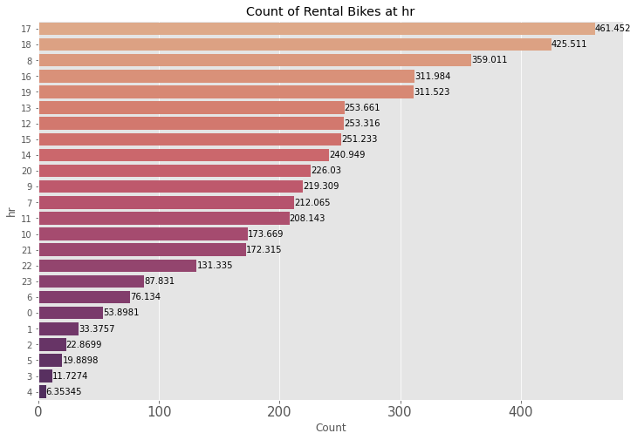
Bar plot

Slide 11
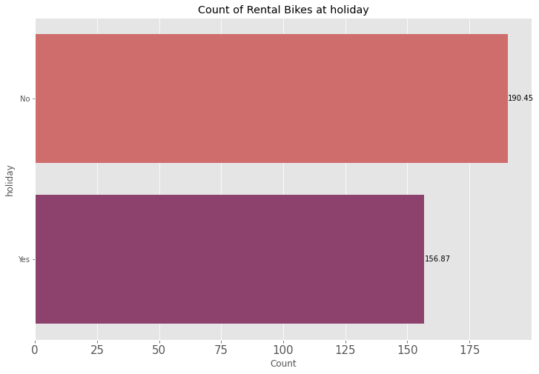
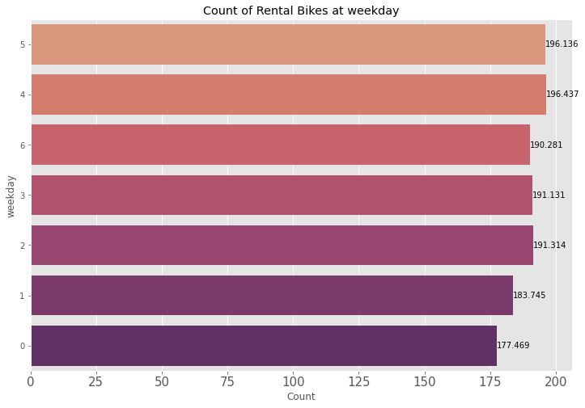
Bar plot

Slide 12
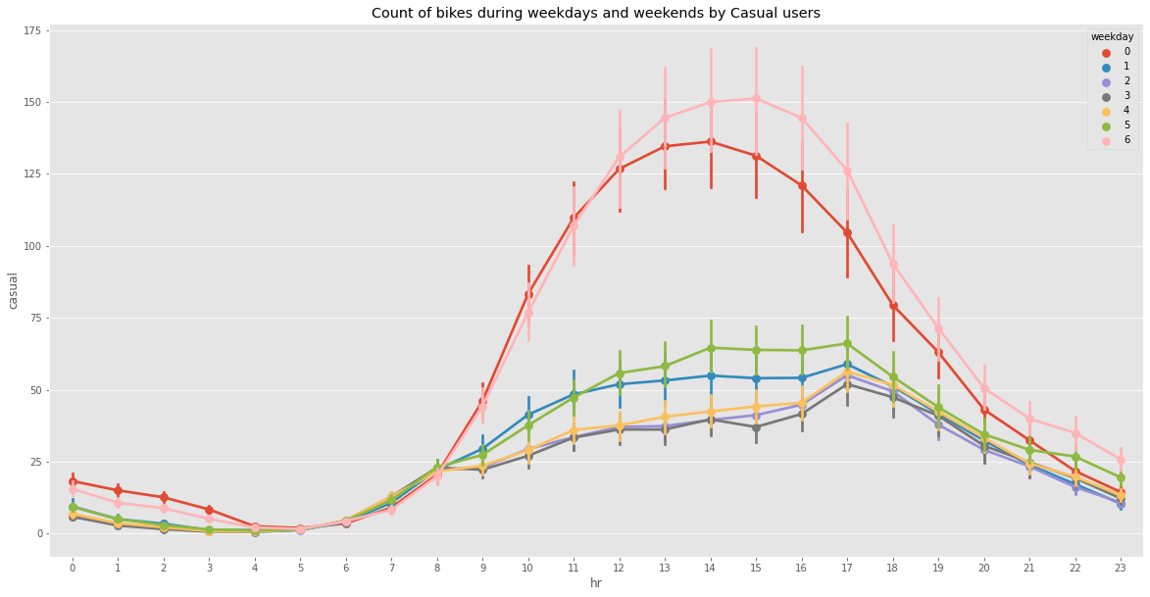
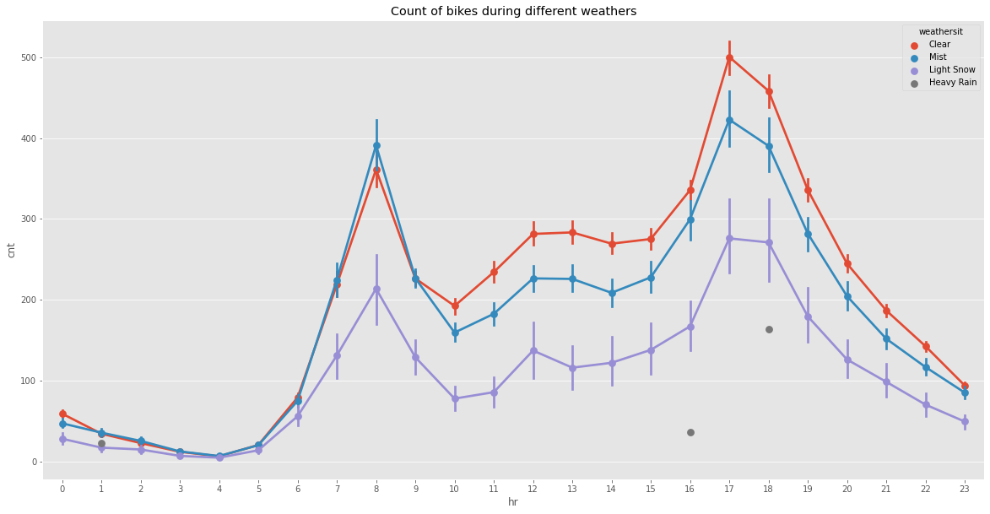
point plot
From the pink and red lines on the graph which represent Saturday and Sunday, there are a huge number of casual users in the weekend mid-day hours
The upper red line is the clear weather.
The two dots are when the weather is heavy rain,
hence no bookings.

Slide 13
FEATURE ENGINEERING
One-hot encoding is a technique used to represent categorical data in a binary format. It involves converting each category into a binary vector where only one element is "hot" or "on" (encoded as 1) while the others are "cold" or "off" (encoded as 0).
The process of one-hot encoding can be summarized as follows:
Identify the distinct categories in the dataset.
Create a binary vector of zeros for each category.
Set the element corresponding to the category to 1 and leave the rest as 0.
Repeat this process for each category, creating a binary vector for each one.
The resulting one-hot encoded vectors provide a numerical representation of categorical variables that can be easily understood by machine learning algorithms. This representation helps to avoid any assumption of ordinality or magnitude between categories and treats them as separate and unrelated values.
Min-max scaling, also known as normalization, is a data preprocessing technique used to rescale numerical features to a specific range, typically between 0 and 1. The goal is to bring all the values within a consistent scale to prevent some variables from dominating others due to their inherent magnitude.
The process of min-max scaling can be summarized as follows:
Identify the minimum and maximum values of the feature.
Subtract the minimum value from each data point.
Divide the result by the difference between the maximum and minimum values.
The scaled values will now fall between 0 and 1, with the minimum value becoming 0 and the maximum value becoming 1.
This scaling technique preserves the relative relationships between the data points while ensuring that they are all within the desired range. It is particularly useful when working with algorithms that are sensitive to the scale of the features, such as distance-based methods or neural networks.

Slide 14
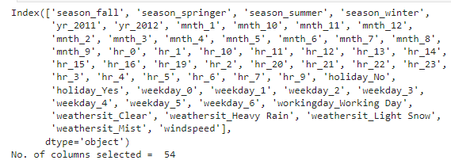
FEATURE SELECTION
UNIVARIATE SELECTION
F-Regression
Chi-Square Test
Tree Based Selection
Bivariate selection
Recursive feature elimination

Slide 15
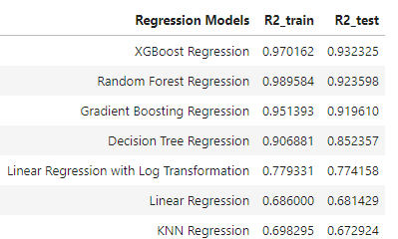
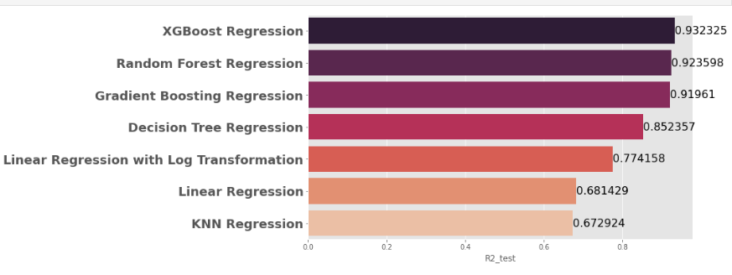
Model training and evaluation

Slide 16
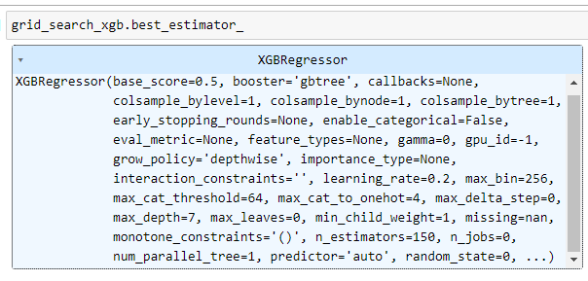
HYPERPARAMETER TUNING
Grid Search:
Grid search is a technique used to find the best combination of hyperparameters for a machine learning model. Hyperparameters are parameters that are not learned from the data but are set before training the model. Examples of hyperparameters include the learning rate, regularization strength, number of hidden layers in a neural network, etc
Cross-Validation:
Cross-validation is a technique used to assess the performance and generalization ability of a machine learning model. The main idea behind cross-validation is to simulate how well the model would perform on unseen data by evaluating it on multiple subsets of the available data..

Slide 17
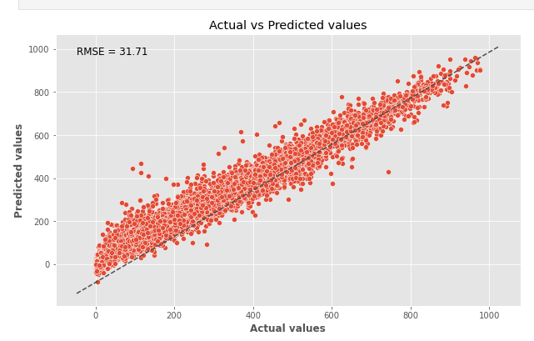
FINAL MODEL
XGBOOST REGRESSOR

Slide 18
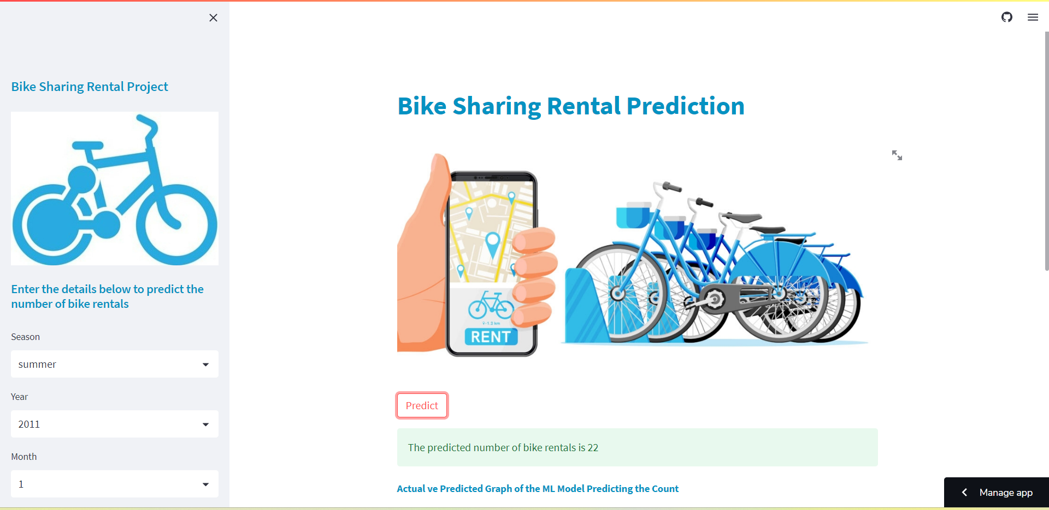
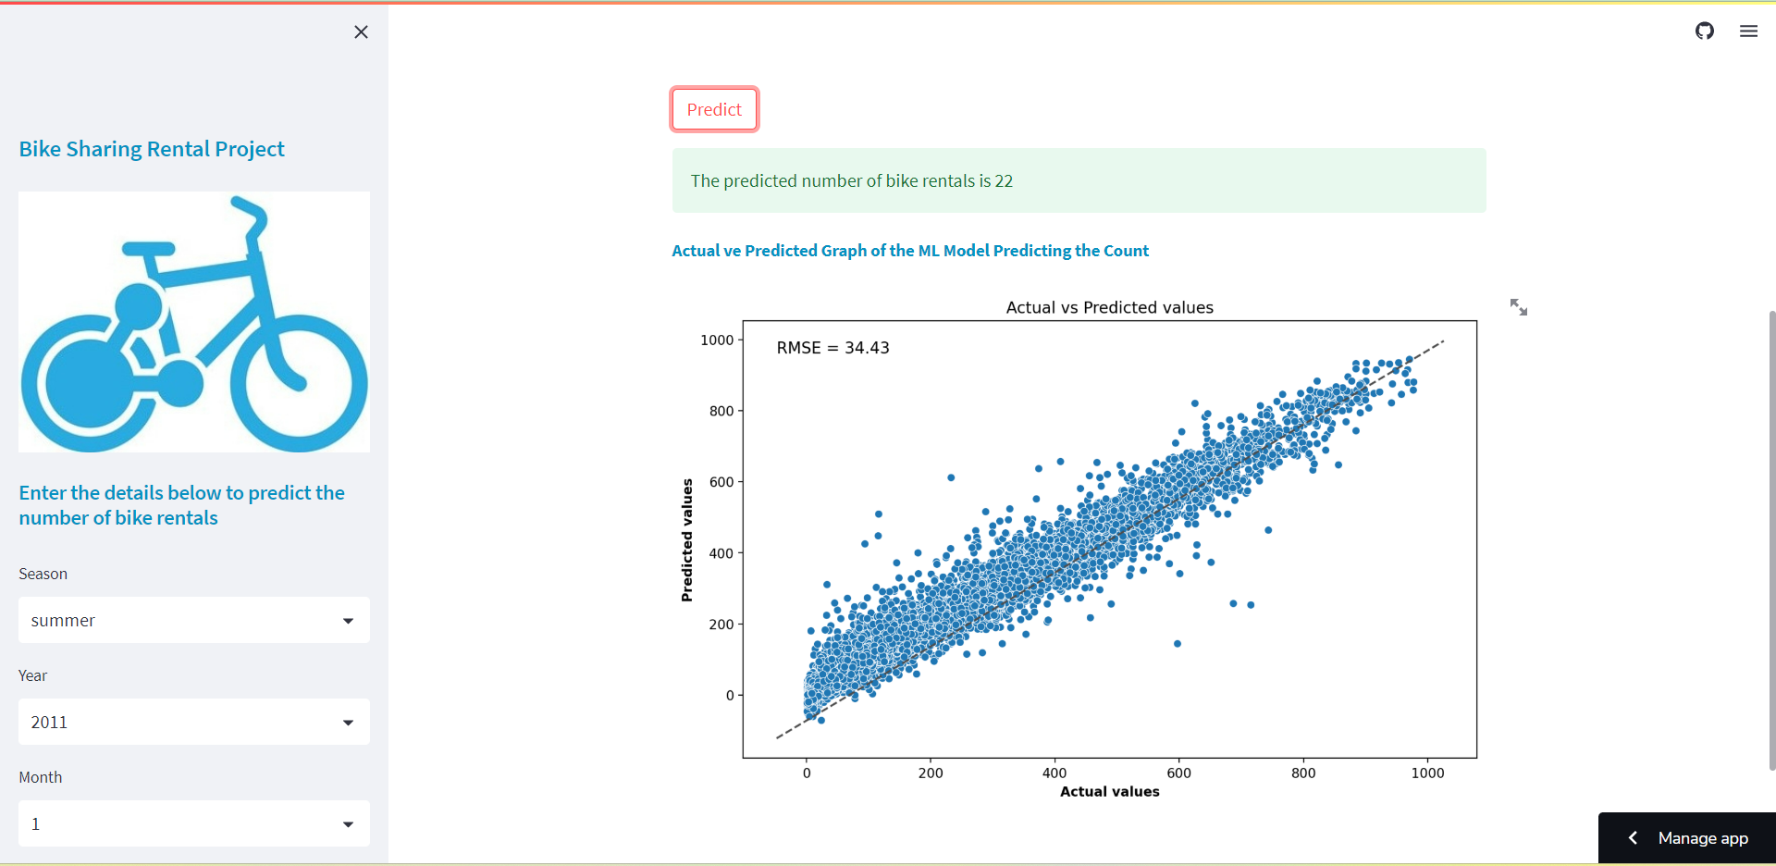
deployment

